Slide 1



Deep Learning Based Sentiment analysis using audio and text Modalities
DIABETIC FOOT ULCER DETECTION USING DEEP
LEARNING APPROACHES
PRESENTED BY GUIDED BY
DATE:
Zeroth Review
1
Department of Computer Science & Engineering
PRESENTED BY
GUIDED BY
SNEKA A - 21CSR196
SRIDHAR D - 21CSR203
SUBHA SHREE V S - 21CSR209
Ms. P.Santhiya
Assistant Professor/CSE
DATE:
26-10-2023

Slide 2
DOMAIN KNOWLEDGE
A Convolutional Neural Network(CNN) is a type of deep learning architecture.
Deep learning encompasses a broader category of neural networks that include not only CNNs but also other architectures like Recurrent Neural Networks(RNNs),Long Short-Term Memory(LSTM) networks, and various types of fully connected networks with many layers.

Slide 3
Why Multi-model Sentiment Analysis?
By considering multiple modalities (text, video, audio), we gain a more comprehensive understanding of sentiment.
Improved Robustness: Analyzing multiple modalities can enhance the robustness of sentiment analysis, making it more resilient to noise or ambiguity in any single modality
Increased Accuracy: Different modalities may convey different aspects of sentiment.

Slide 4
PROBLEM STATEMENT
Classifying the polarity of a given text at the document, sentence or feature/aspect level
Whether the expressed opinion in a document, a sentence or an entity feature aspect is positive, negative ,or neutral.

Slide 5
OBJECTIVES
Implement preprocessing techniques specific to each modality, addressing challenges such as text cleaning, feature extraction from text, and audio-visual feature representation.
Design and train a multi-modal sentiment analysis model capable of capturing the subtleties and correlations between different modalities to enhance prediction accuracy.
Explore and implement effective strategies for fusing features extracted from both textual and audio-visual modalities, ensuring a synergistic representation for sentiment analysis.
Develop or integrate the sentiment analysis model into a user-friendly interface, allowing users to interact with and interpret the sentiment predictions.

Slide 6
EXISTING SYSTEM
This paper explores the use of audio-visual modalities and 3D convolutional neural networks in emotion recognition (ER).
It aims to enhance recognition rates by combining visual and audio data.
Experiments were conducted on three datasets RML, SAVEE and eNTERFACE’05.
Resulting in three multimodal systems: video-referenced, audio-referenced, and audio-visual-referenced.

Slide 7
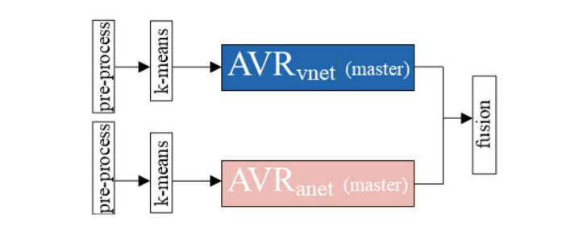
EXISTING FRAMEWORK/BLOCK DIAGRAM

Slide 8
LITERATURE SURVEY
https://docs.google.com/spreadsheets/d/1meYG7C1NN36zG1GeMIz0spiFSwnc1DGvAnJpZGDCxu8/edit?usp=drivesdk

Slide 9
PROPOSED WORK
In our upcoming paper, we will harness the power of deep learning while working with a carefully selected dataset containing both audio and text components.
Our approach involves training dedicated models for audio and text data, followed by the fusion of their features.
This fusion model is instrumental in achieving the desired results for multimodal sentiment analysis, ultimately enhancing the accuracy and robustness of the sentiment prediction process.

Slide 10
LIST OF IDENTIFIED MODULES
Data Collection
Pre – Processing
Feature Extraction
Train Model
Evaluate Model

Slide 11
IMPLEMENTATION OF COMPLETED MODULES
Load data
Data preprocessing
Gathered Dataset from Kaggle,UCI repository

Slide 12
ARCHITECTURE/FLOWCHART
Data Collection
Preprocessing
Audio Preprocessing
Video Preprocessing
Feature Extraction
Classification
Prediction of the sentiment
Fusion Algorithm

Slide 13
REFERENCES
1.Noushin Hajarolasvadi, Hasan Demirel, "Deep Emotion Recognition based on audio-visual correlation.,2020,doi:10.1049/iet-cvi.2020.0013.
2.Asif Iqbal Middya, Baibhav Nag, Sarbani Roy, "Deep learning based multi-model emotion recognition using model-level fusion of audio-visual modalities".2022,doi:10.1016/j.knosys.2022.108580.
3.Huiru Wang, Xiuhong Li,"Multimodel sentiment analysis representation learning via contrastive learning with condense attention fusion",2023,doi:10.3390/s.23052679.

Slide 14
THANK YOU

